Slide 1
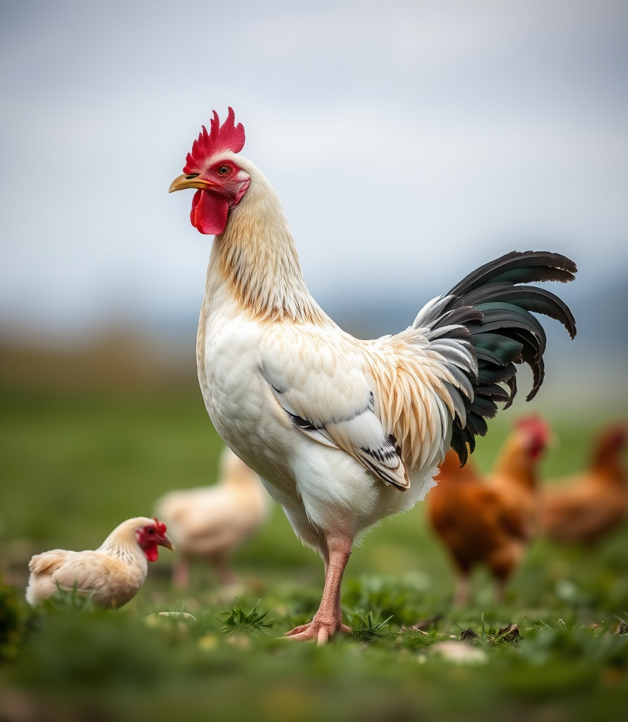
Transfer Learning Based Classification of Poultry Diseases for Enhanced Health Management
K.PAVITHRA,S.MOHAMMED ADIL

Slide 2
Introduction
• Automated disease detection through image analysis
• Reduced veterinary costs and improved efficiency
• Enhanced animal welfare through early intervention
• Sustainable farming practices with data-driven decisions

Slide 3
Objective
• Classify poultry diseases using a deep learning model.
• Build an interactive web application with Streamlit.
• Leverage transfer learning for high accuracy with minimal training data.

Slide 4
Key Challenges
• Late Detection: Symptoms often appear after significant spread
• Human Error: Subjective assessment leads to misdiagnosis
• Resource Intensive: Requires extensive veterinary expertise
• Economic Impact: Disease outbreaks cost industry $4.2 billion annually
• Scalability Issues: Difficult to monitor large flocks effectively

Slide 5
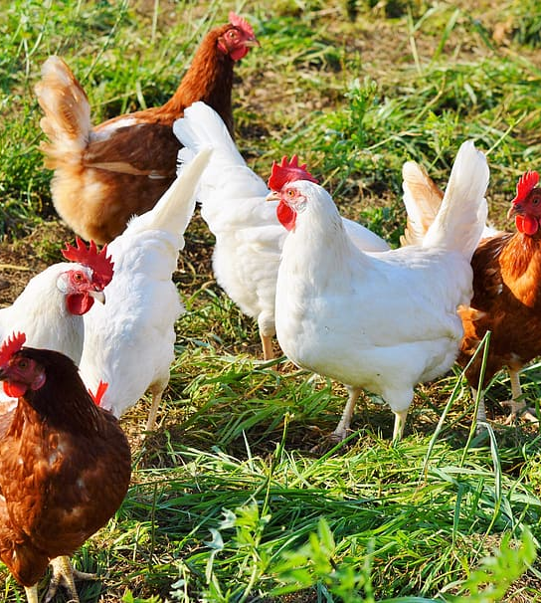
Targeted Diseases
• Healthy
• Newcastle Disease
• Salmonella
• Coccidiosis

Slide 6
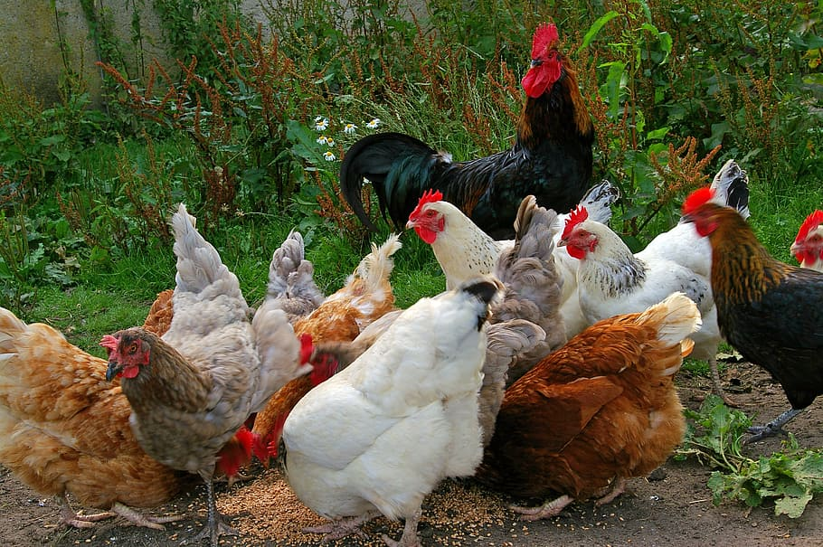
Methodology Overview
Data collection and preprocessing
Model creation using MobileNetV2
Training and validation
Streamlit app deployment
6

Slide 7
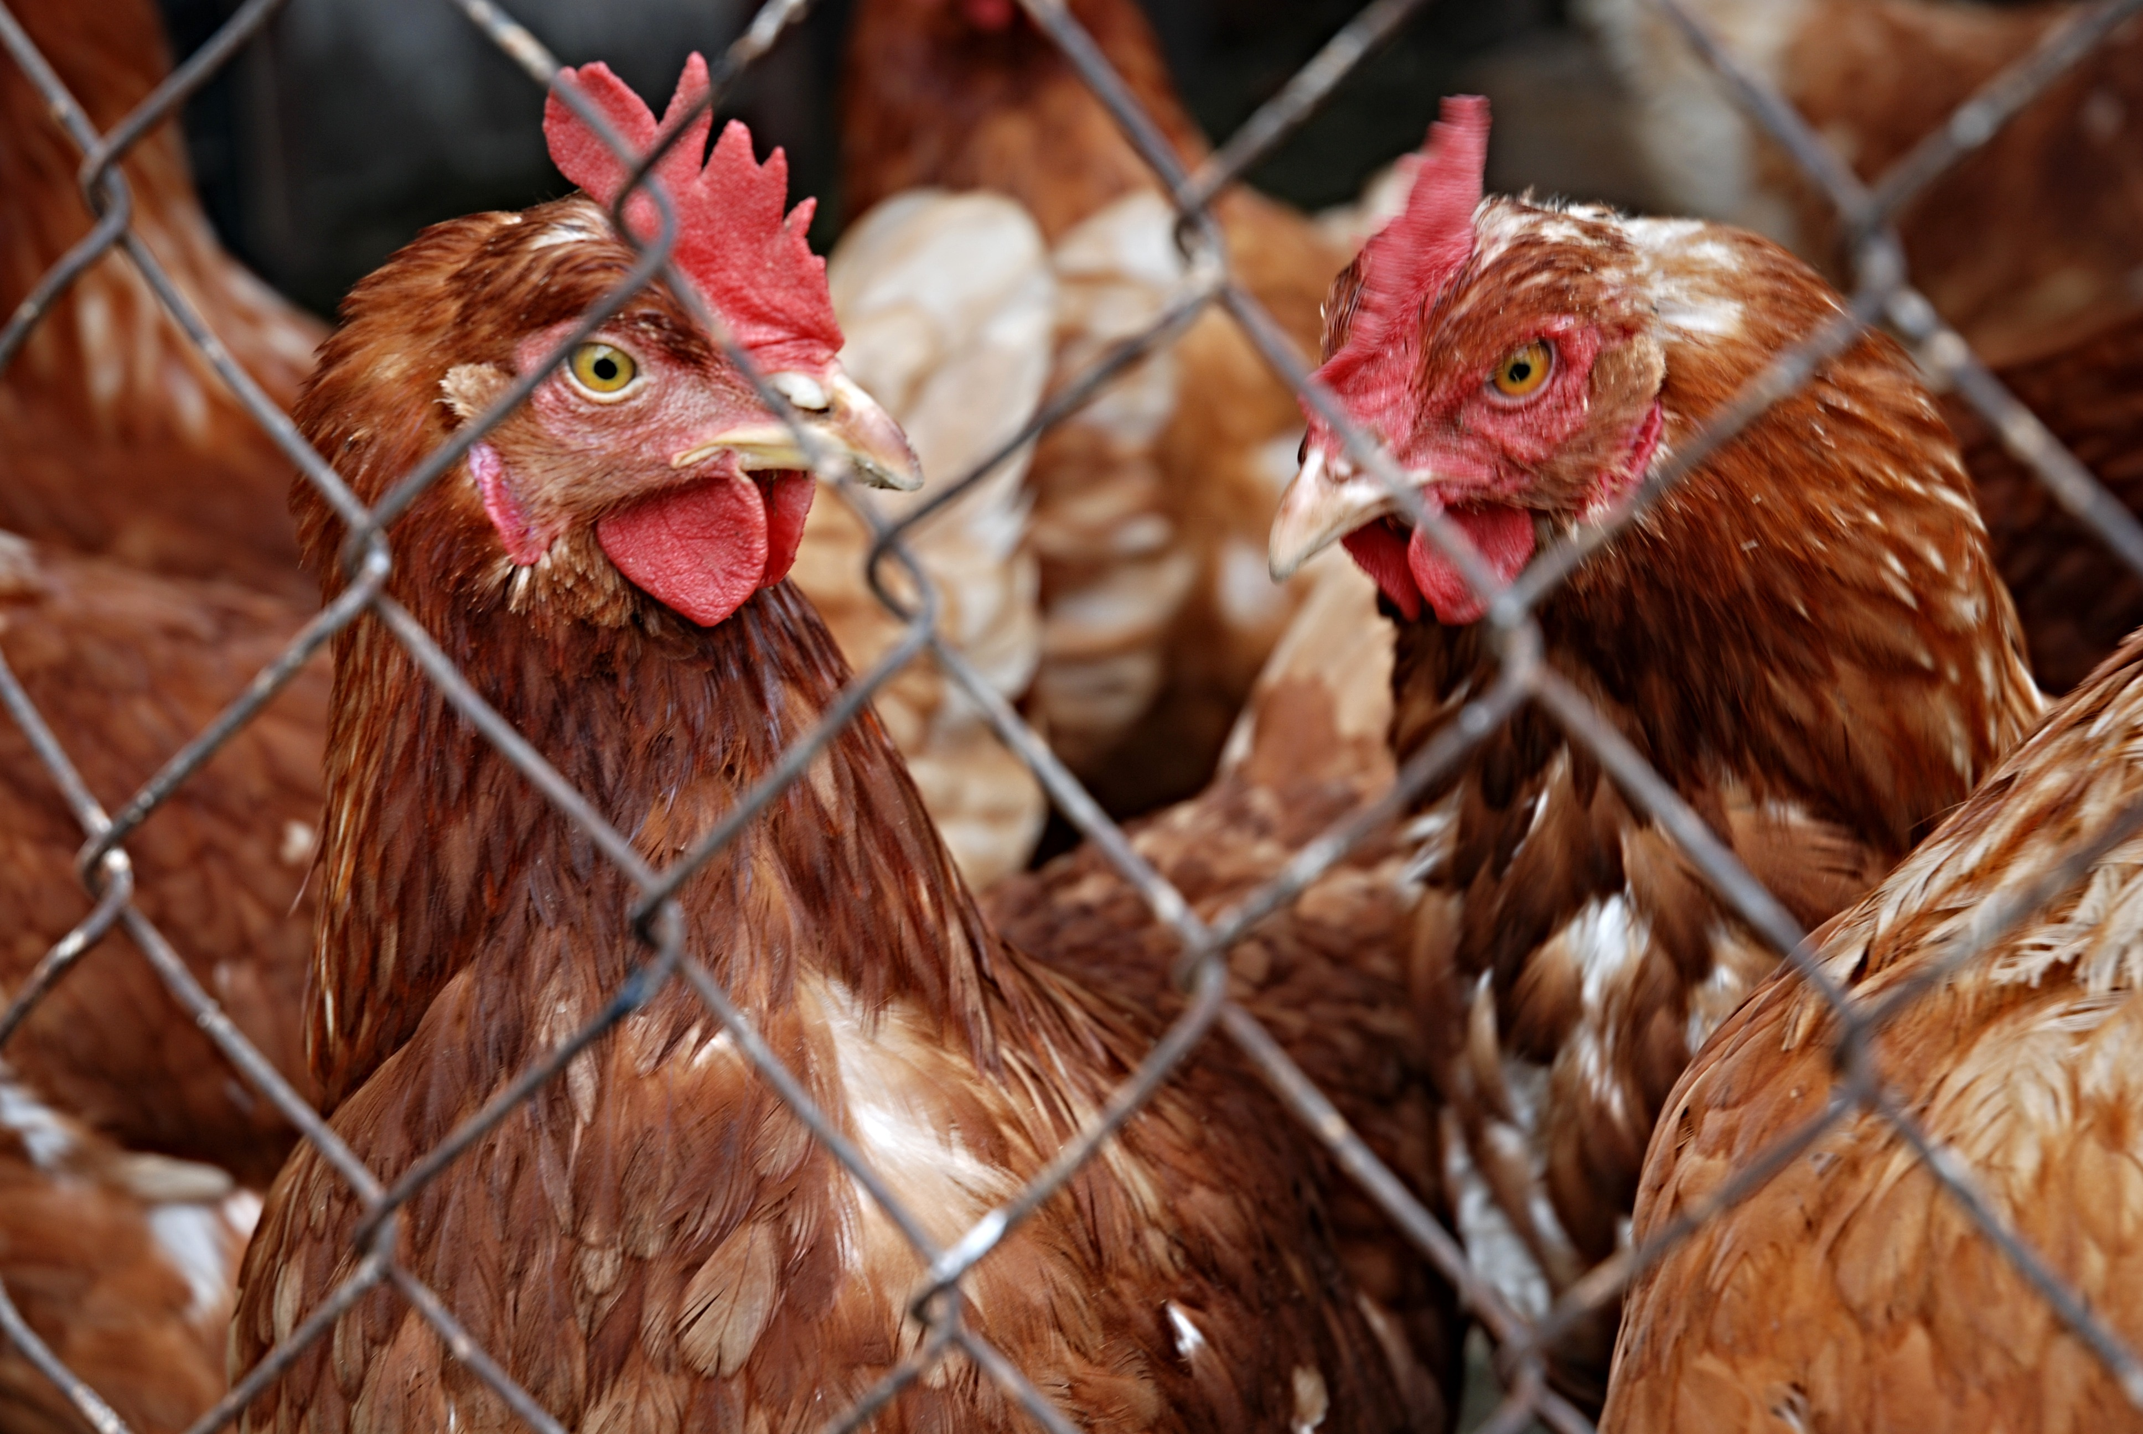
Transfer Learning Architecture
• MobileNetV2 used as the base model (ImageNet weights).
• Added GlobalAveragePooling and Dense layers.
• Final layer: Softmax for multi-class classification.
7

Slide 8
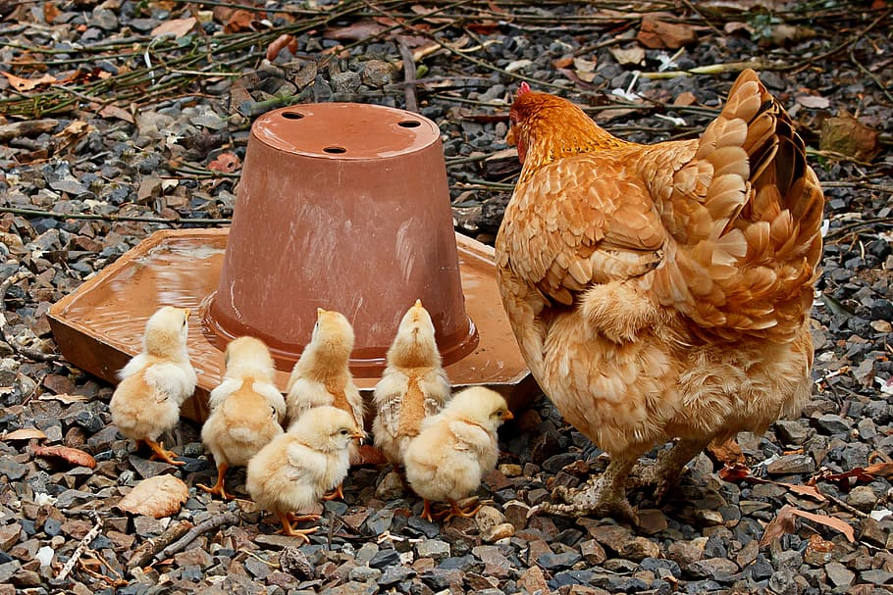
Dataset Structure
Folder Structure:
data/train/
├── Healthy/
├── Newcastle Disease/
├── Coccidiosis/
└── Salmonella/
Images resized to 224x224 and normalized.
8

Slide 9
Streamlit Application
• Upload image via web UI
• Model makes real-time prediction
• Result and confidence displayed
• Simple and interactive interface

Slide 10
Advantages of the System
• Fast and cost-effective disease detection
• Reduces dependency on manual diagnosis
• Accessible to non-experts

Slide 11
Conclusion
• A working system to classify poultry diseases
• Combines AI with an easy-to-use interface
• Encourages smarter poultry management

